Slide 1

August 1, 2023
Health Equity Ambassador – Disparities & Risk Presentation

Slide 2





Collaboration for Equitable Health
What
Through a powerful collaboration, the American Heart Association, American Cancer Society, and American Diabetes Association supported by Bank of America, launched a collaboration for equitable health to advance health outcomes for Black, Hispanic-Latino, Asian American, and Native American individuals, and communities.
Why
Health inequities for communities of color have only been exasperated in the wake of the pandemic; communities of color have the top five leading causes of death in common: Heart Disease, Cancer, Unintentional Injury, Stroke and Diabetes with Heart Disease and Cancer ranking as the top two.
How
  Utilize a place-based approach in partnership with a network of health care organizations, community partners, and stakeholders, focused on three key priorities.
ACCESS
ACTIVATE
ADVOCATE
Increase equitable provision and utilization of evidence-based strategies to support prevention, early detection/diagnosis, and treatment of hypertension, diabetes, and cancer.
Amplify knowledge, remove barriers, and create pathways to reduce long-standing health disparities in hypertension, diabetes, and cancer.
Collaborate and support communities to effectively advocate for equitable health by advancing their ability for sustained public policy advocacy.
Notes:
LaToya, Cyndie or Tawana to facilitate:
As we all know, prior to the pandemic there were health inequities among communities of color. During the pandemic, those health inequities were only exacerbated. The pandemic emphasized the historic and systemic gaps in American health care. As a result, we know that now more than ever, addressing barriers to health equity are critical for these communities to realize true economic mobility.
In response to this, the American Cancer Society, American Diabetes Association, and American Heart Association supported by Bank of America, launched a powerful collaboration for equitable health to advance health outcomes for Black, Hispanic-Latino, Asian American, and Native American individuals, and communities. This is a 4 year initiative and, as a collective, we are focusing on 11 markets across the U.S., with a focus on health equity in our partner communities.
Focusing on Communities of color is crucial as communities of color have the top five leading causes of death in common: Heart Disease, Cancer, Unintentional Injury, Stroke and Diabetes with Heart Disease and Cancer ranking as the top two.
For this collaboration we will be utilizing a place-based approach in partnership with a network of health care organizations, community partners, and stakeholders, focused on three key priorities, which include prevention and access, community education and activation, and policy and advocacy.
Prevention and Access is focused on Increasing equitable provision and utilization of evidence-based strategies to support prevention, early, detection/diagnosis, and treatment of hypertension, diabetes, and cancer. The target audience is healthcare organizations, and the work will center around
Disseminating and promoting evidence-based clinical guidelines that support delivery of care, screening for prevention, and treatment of conditions of interest
Conducting provider training on evidence-based clinical guidelines that support delivery of care, screening of prevention, and treatment of conditions of interest
Supporting health care organizations via funding, technical assistance & other support services
Dissemination of/Training on SDOH screening tools in the clinical setting
Community Education and Activation is focused on Amplifying knowledge, removing barriers, and creating pathways to reduce long-standing health disparities in hypertension, diabetes, and cancer, the target audience is Community- Based, faith based Organizations, community members, and health partners and the work will center around
Dissemination of risk reduction training offered by ACS, ADA or AHA
Dissemination of/Training on SDOH screening tools
Supporting community-based organizations via funding, technical assistance & other support services
Policy and Advocacy is focused on Collaborating and supporting communities to effectively advocate for equitable health by advancing their ability for sustained public policy advocacy, the target audience is Community- Based Organizations + Public Officials + Public/Consumers , and the work will center around
Engaging stakeholders & community leaders to identify & support priority public policy issue campaigns
Empowering & supporting community-led coalitions to advance sustainable policy solutions, mobilize voice in support of policy & engage public officials
Supporting community-led coalitions via funding, technical assistance & other support services
Informing, educating & influencing public policy, decisions & votes that support public policy advancement
Mobilizing via community organizing, grassroots training, & related technology & social media platforms
Conducting public polling, public information campaigns, and community spokesperson training to build support for policy issues
Supporting efforts via funding, technical assistance & other support services

Slide 3




Collaboration for Equitable Health
Bank of America Cross-Agency Initiative
₊
4
Partnership Engagement
Year Initiative
11
₊
Focus Markets Nationally
In-Market Community Based Organizations
Our Health Equity Ambassador program has reached:
485K
2100
People
Volunteer Ambassadors Trained
Notes:
Now that we have some foundational knowledge about what the initiative is and how the three pillars of access, activate, and advocate play a in how we will approach health equity in our communities, we can go into what American Cancer Society is doing in the activate space to Amplify knowledge, remove barriers, and create pathways to reduce long-standing health disparities in cancer. We are leading this work with our health equity ambassadors program, why you're all here today!
Our health equity ambassador program has been implemented by other community partners like yourselves and the response has been great. Not only have we trained over 2100 ambassadors, but their community outreach has reached over 485,000 people in communities across the U.S.
So thank you for being part of the training that is evidence based and has proven to provide reach in communities through the work of ambassadors like yourselves.

Slide 4

Vision: End cancer as we know it, for everyone.
Mission: Improve the lives of people with cancer and their families through advocacy, research, and patient support, to ensure everyone has an opportunity to prevent, detect, treat, and survive cancer.
Action through advocacy
Patient Support
Advancing discovery
Every cancer. Every life.
HEALTH EQUITY
Notes:
We are working to:
* launch innovative, high-impact research
* improve equitable access to care
* increase cancer screening rates
* reduce long-standing disparities in cancer prevention, diagnosis, and treatment outcomes

Slide 5

Advancing Health Equity & Understanding Cancer Disparities

Slide 6


Equity vs. Equality
Notes:
Equity is not the same as equality. Equality is providing everyone with the same tools and resources. Equity is providing tools and resources based on needs that allow everyone the opportunity to be as healthy as possible.​

Slide 7

What is a Health Disparity?
A health disparity is when the quality of health care differs between people because of discrimination based on:
Age
Disability status
Health insurance coverage
Gender identity
Geography (where a person lives)
Income
Race or ethnicity (racism)
Notes:
Cancer is a disease that can affect anyone, but it doesn’t affect everyone equally.
Many social structures and practices can limit a person’s access to health care they need to prevent, treat, and survive cancer. These obstacles may include racism, discrimination, poverty, lack of access to healthy and affordable foods, low quality education and housing, and jobs with inadequate pay.
Health care disparities can affect every step of cancer care — from prevention and screening to the quality of life after cancer treatment, which means disparities in care can affect who develops and dies from cancer.

Slide 8

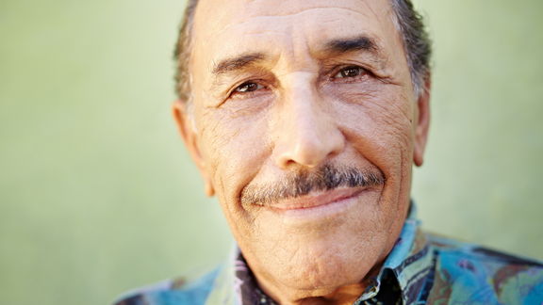



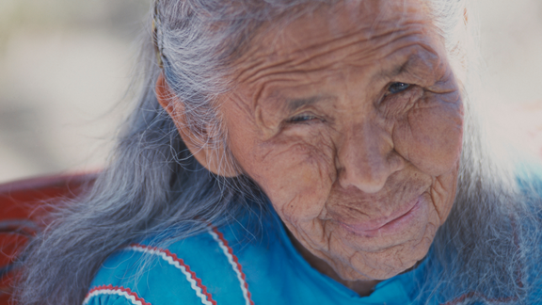
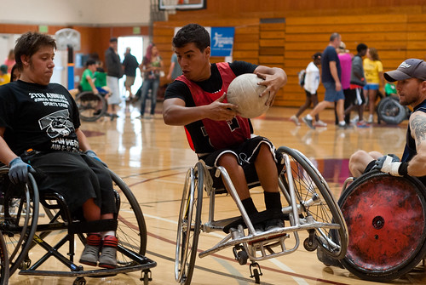
Leading the Way in Addressing Health Disparities
No one should be disadvantaged in their fight against cancer because of how much money they make, the color of their skin, their sexual orientation, their gender identity, their disability status, or where they live.
Black
Communities
Latinx
Communities
Asian American Communities
LGBTQ
Communities
Rural
Communities
Indigenous
Communities
Disabled
Communities
Blacks have the highest death rate for most cancers and shortest survival of any racial/ethnic U.S. group.
Latino/Latina populations are more likely to be uninsured when compared to all other racial & ethnic groups.
Among Asian men, the 3 leading causes of cancer death are lung, liver, and colorectal. Among Asian women, they are lung, breast, and colorectal.
Some studies suggest both tobacco and alcohol use are up to 1.5 times higher in the LGBTQ+ population, which likely create higher risks for tobacco and alcohol-related diseases, including certain cancers.
The poverty rate in the U.S. is 10.5% and that rate is much higher in various rural markets.
American Indians
are less likely to
have had a recent mammogram; American Indian and Alaska Native men are 2nd only to Black men in prostate cancer death rates.
CDC data shows that differently abled people are less likely to receive recommended cancer screening tests than those without disabilities.
Notes:
The American Cancer Society is committed to addressing the unequal burden by reaching people in underserved communities.
> The solution for fighting injustices in health care begins by taking a look at the at-risk communities most impacted by the obstacles standing in their way
[ Read through Critical Communities ]
> How can we help our at-risk communities overcome their obstacles and beat the odds?
> Part of the solution starts with calling on a new legion of “heroes” willing to fight for our neighbors, our friends, and our loved ones. They need our help.
Disability Notes:
According to the Center for Disease Control and Prevention, in 2013 about 1 in 5 adults had a disability
CDC data shows that differently abled people are less likely to receive recommended cancer screening tests than those without disabilities.
There are varied reasons why those with disabilities have trouble accessing healthcare, including lack of transportation and the ability to schedule an appointment. As a result, differently abled persons typically have lower cancer screening rates than those without disabilities, making it more likely that their cancer will be found later, when it is harder to treat.
Barriers to Screening
The most common reasons people gave for not getting screened were—
Difficulty getting an appointment (9% of people with a disability and 5% of people without a disability).
Wait time at the clinic is too long (7% of people with a disability and 3% of people without a disability).
No transportation to the clinic (7% of people with a disability and 1% of people without a disability).
The American Cancer Society believes that everyone should have a fair and just opportunity to prevent, detect, treat, and survive cancer.
Citation
Steele CB, Townsend JS, Courtney-Long EA, Young, M. Cancer screening prevalence among adults with disabilities, United States, 2013. Preventing Chronic Disease 2017; 14:160312

Slide 9
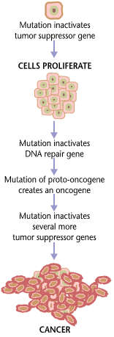
WHAT IS CANCER?
Cell Changes
Cells Grow
Cancer Cells
Cancer
More than 100 diseases
Cells are the basic building blocks of the body.
Cancer is abnormal cells that grow out of control.

Slide 10

OVERVIEW OF BREAST CANCER
Breast cancer is the most common cancer in American women, except for skin cancers
The average risk of a woman in the United States developing breast cancer sometime in her life is about 13%.
This means there is a 1 in 8 chance she will develop breast cancer.
    This also means there is a 7 in 8 chance she will never have the disease.

Slide 11
OVERVIEW OF COLORECTAL CANCER
Cancer that begins in the colon and rectum (bowels).
The colon and rectum are part of the digestive system (where food is processed in the body).
Colorectal Cancer usually develops from pre-cancerous growths (known as polyps)in the lining of the colon or rectum.
Finding and removing polyps can help prevent Colorectal Cancer from occurring.

Slide 12
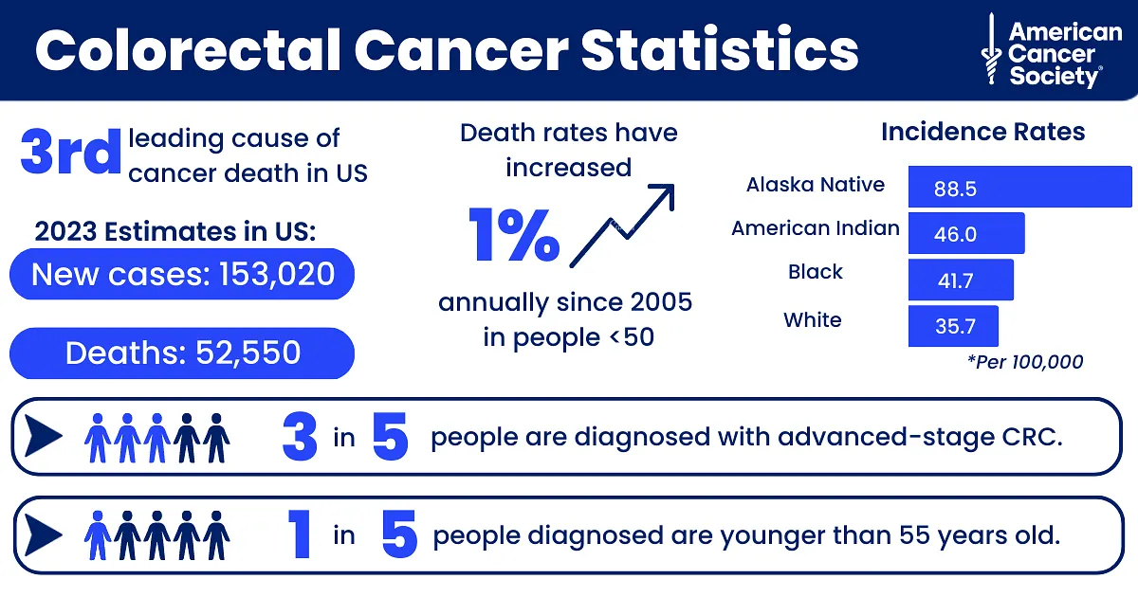
Notes:
CRC is the 3rd leading cause of cancer death. The incident rates are incredibly high for the Alaska Native/American Indian followed by blacks and whites. This is the one cancer that can be prevented through screening yet the death rates are trending in the wrong direction.

Slide 13
COLORECTAL CANCER RATES
The rate of people being diagnosed with Colorectal Cancer each year has dropped overall since the mid-1980s, mainly because more people are getting screened and changing their lifestyle related risk factors.
The death rate from Colorectal Cancer has been dropping in both men and women for several decades.
  One reason is that colorectal polyps are now being found more often by screening and removed before they can develop into cancers, or cancers are being found earlier when they are easier to treat.
  Another reason is that treatments for Colorectal Cancer have improved over the last few decades.
There are now more than 1.5 million survivors of Colorectal Cancer in the United States.

Slide 14
What is prostate cancer?
Cancer is the growth of abnormal cells.
Cancer cells can invade and damage normal tissue.
Prostate cancer starts in the epithelial cells of the prostate.
Some prostate cancers can grow and spread quickly, but most of them grow slowly.
Notes:
Almost all prostate cancers are adenocarcinomas. These cancers develop from the gland cells (the cells that make the prostate fluid that is added to the semen).
Other types of cancer that can start in the prostate include:
Small cell carcinomas
Neuroendocrine tumors (other than small cell carcinomas)
Transitional cell carcinomas
Sarcomas
These other types of prostate cancer are rare. If you are told you have prostate cancer, it is almost certain to be an adenocarcinoma.
Some prostate cancers grow and spread quickly, but most grow slowly. In fact, autopsy studies show that many older men (and even some younger men) who died of other causes also had prostate cancer that never affected them during their lives. In many cases, neither they nor their doctors even knew they had it.

Slide 15

Prostate Cancer
The exact cause of prostate cancer is not known.
Most likely cause is related to changes in the genetic material (DNA) in our cells (gene mutations).
DNA changes can be passed down through families or can occur due to environment or lifestyle factors.
Notes:
Bullet 2:
DNA is the substance in our cells that makes up our genes, which are the instructions for how a cell works. Changes in DNA, called mutations, can cause cancer.
Bullet 3:
More information on gene mutations, which can be inherited or acquired later in life:
Inherited gene mutations: These are genes that are passed on from generation to generation. Inherited gene changes are thought to play a role in about 10% of prostate cancers. Several inherited genes have been linked to hereditary prostate cancer, including BRCA1 and BRCA2; CHEK2, ATM, PALB2, and RAD51D; DNA mismatch repair genes (such as MSH2, MSH6, MLH1, and PMS2); RNASEL (formerly HPC1); and HOXB13.
Acquired gene mutations: Changes that take place during a person’s life. These mutations are not passed on to children. These changes are found only in cells that come from the original mutated cell. These are called acquired mutations. Most gene mutations related to prostate cancer seem to develop during a man's life rather than having been inherited.

Slide 16
Prostate Cancer Statistics
The most common cancer in men in the U.S., with 288,300 new cases in 2023
The second leading cause of cancer-related death in men in the U.S.,
with 34,700 deaths in 2023
Notes:
Bullet 1: Other than skin cancer. About 1 in 8 men will be diagnosed with prostate cancer during their lifetime.
Bullet 2: Lung cancer is the #1 cause of cancer-related death in U.S. men, followed by prostate cancer. About 1 in 41 men will die of prostate cancer. (Overall #1 cause of death in men is heart disease). The American Cancer Society estimates that in 2022, 34,500 men will die from prostate cancer.
The American Cancer Society relies on information from the SEER (Surveillance, Epidemiology, and End Results) database, maintained by the National Cancer Institute (NCI), to provide survival statistics for different types of cancer.
The SEER database tracks 5-year relative survival rates for prostate cancer in the United States, based on how far the cancer has spread. The SEER database, however, does not group cancers by AJCC TNM stages (stage 1, stage 2, stage 3, etc.). Instead it groups cancers into localized, regional, and distant stages.
Localized: There is no sign that the cancer has spread outside the prostate.
Regional: The cancer has spread outside the prostate to nearby structures or lymph nodes.
Distant: The cancer has spread to parts of the body farther from the prostate, such as the lungs, liver, or bones.

Slide 17
Racial & Ethnic Disparities

Slide 18
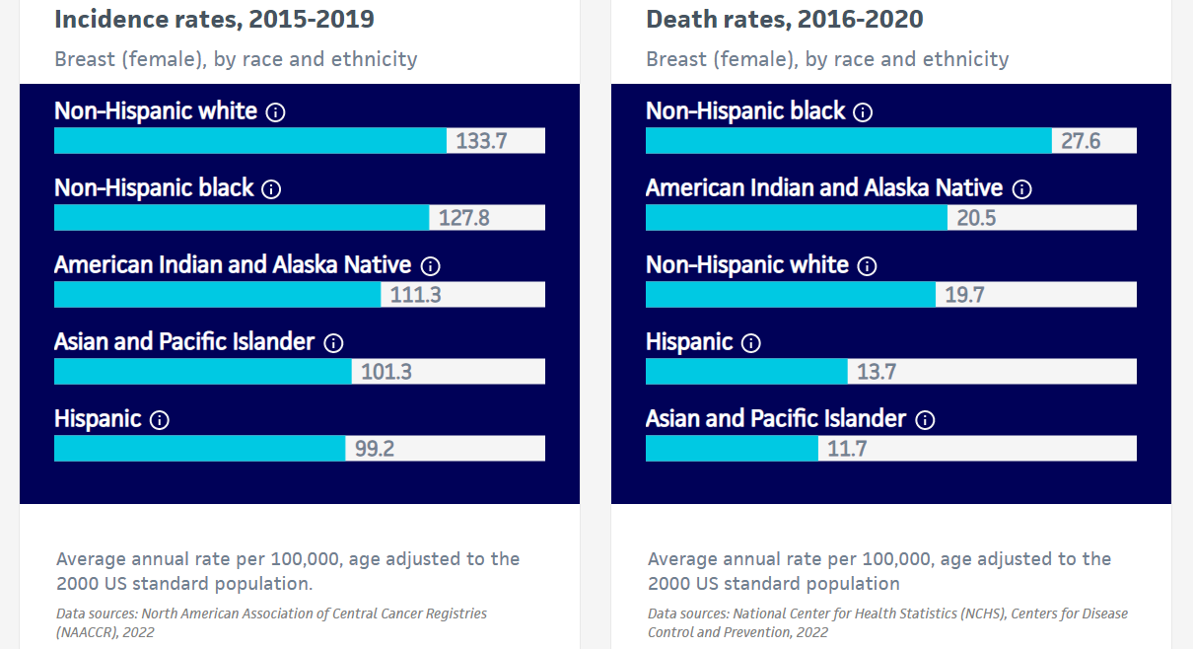
BREAST CANCER RATES

Slide 19
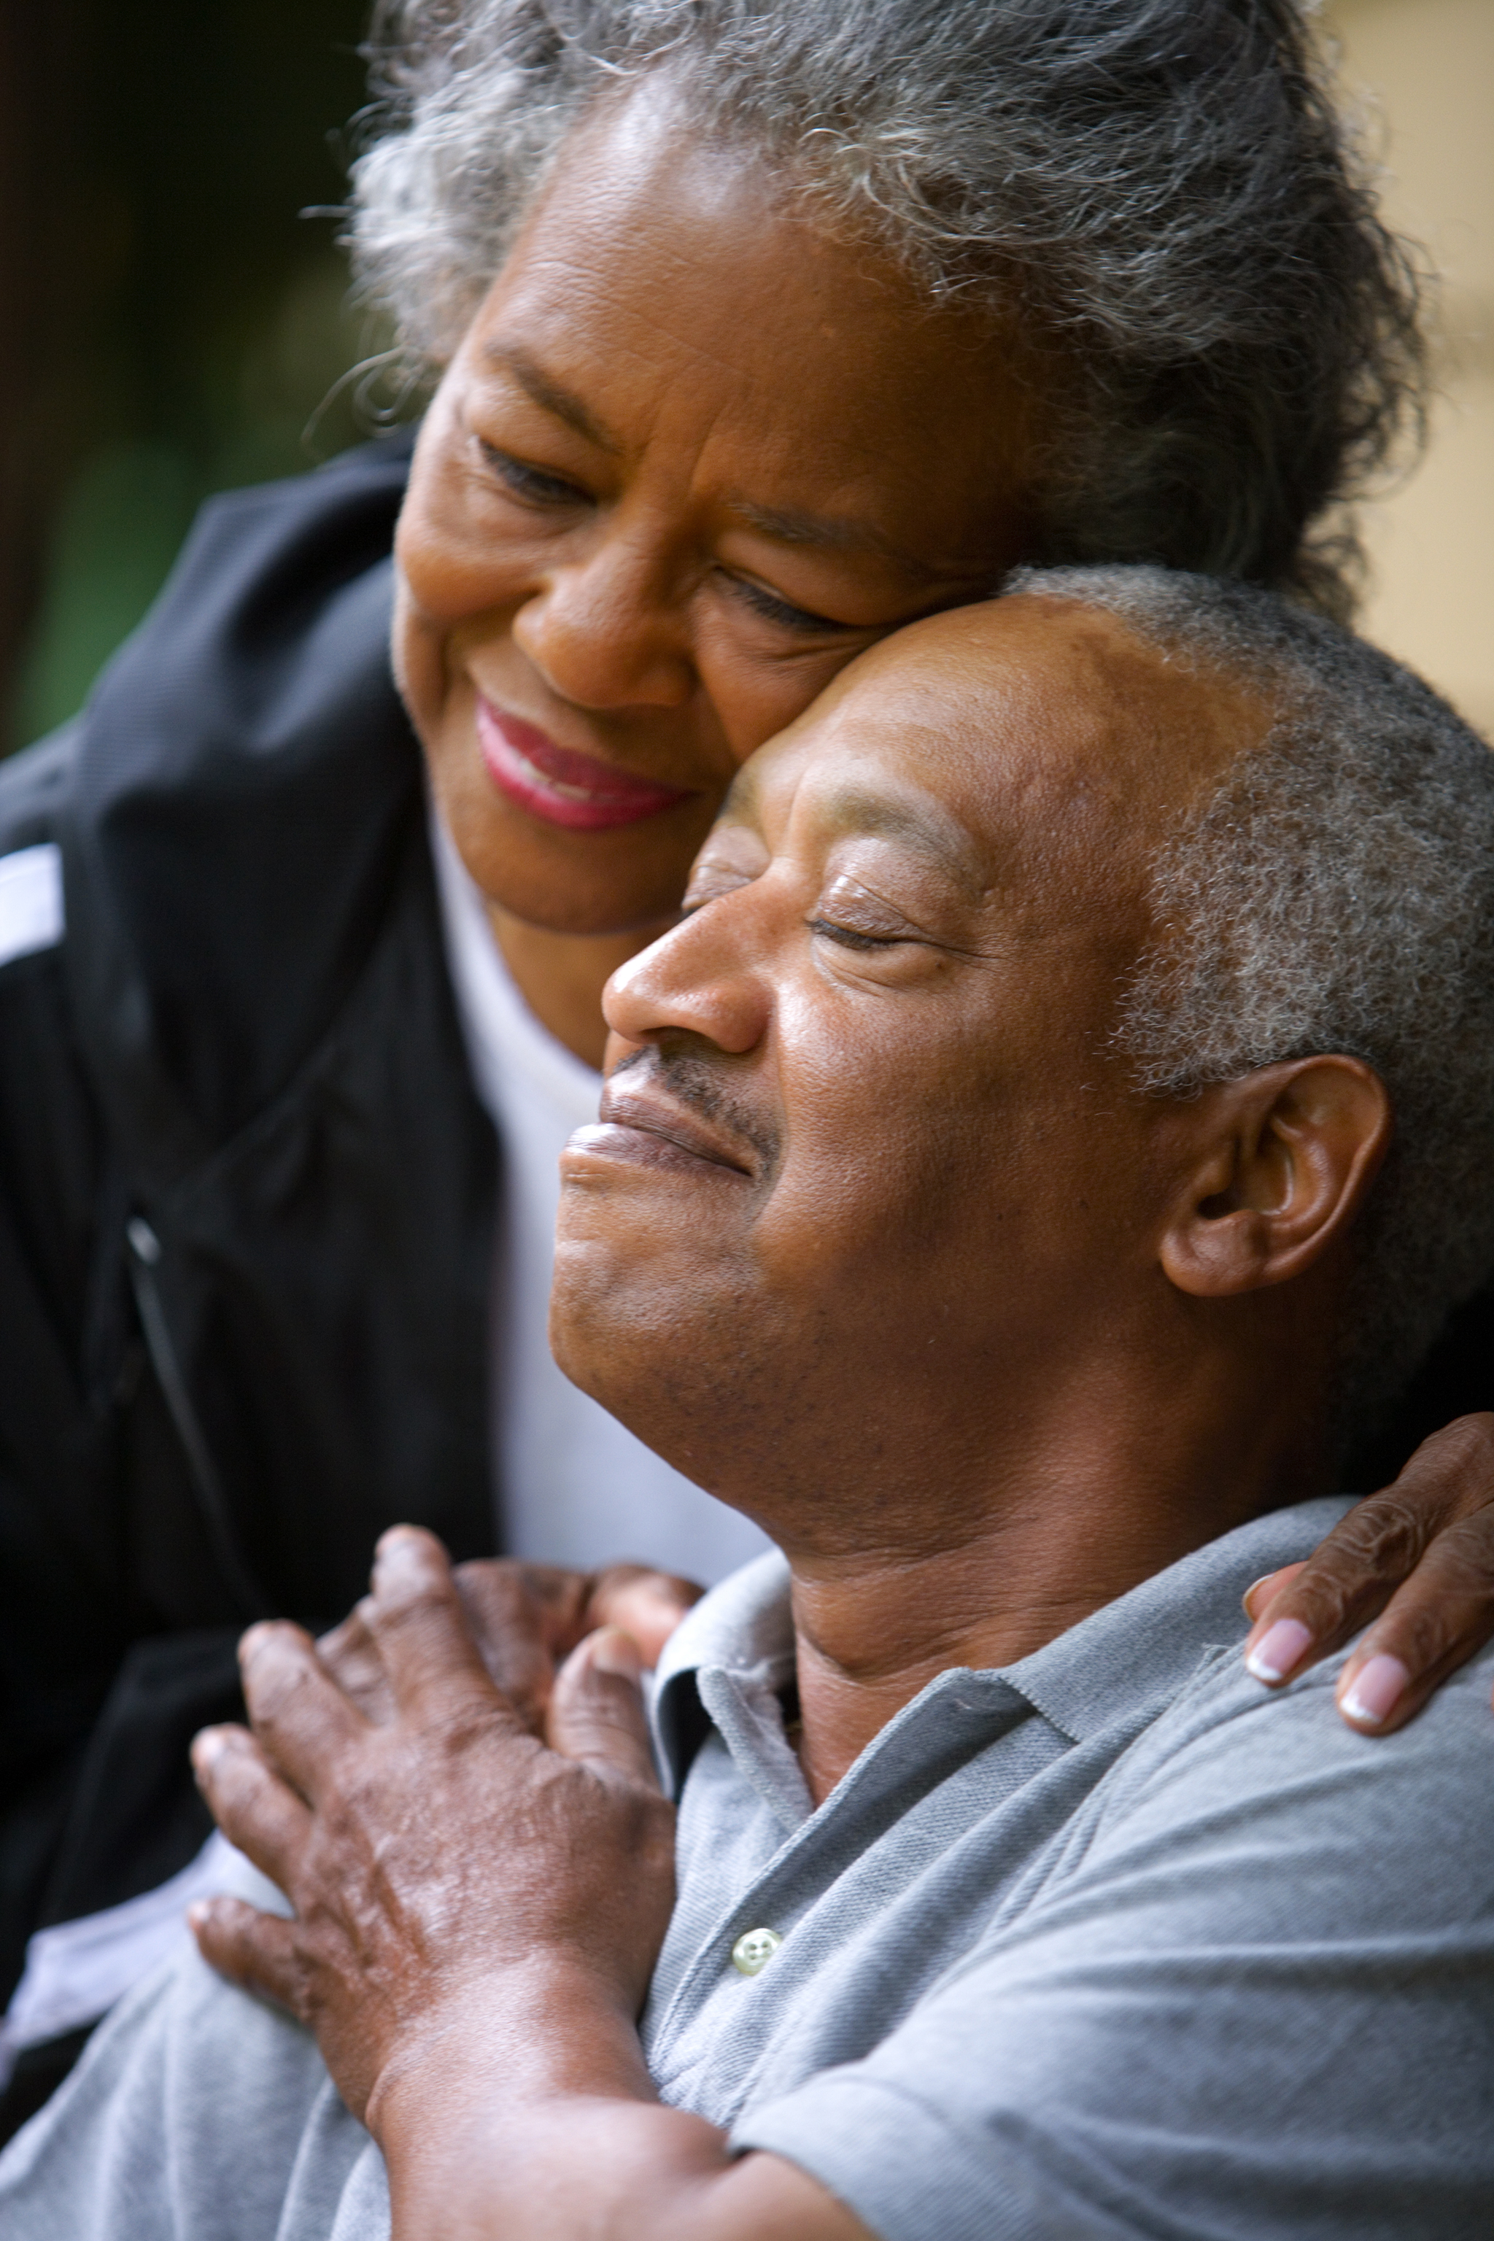
African Americans and Health Disparities in Breast Cancer
Second leading cause of cancer death among African American women.
40% more likely to die of breast cancer than White women and are twice as likely to die if they are over 50.
About a third of African American women reported experiencing racial discrimination at a health provider visit.

Slide 20
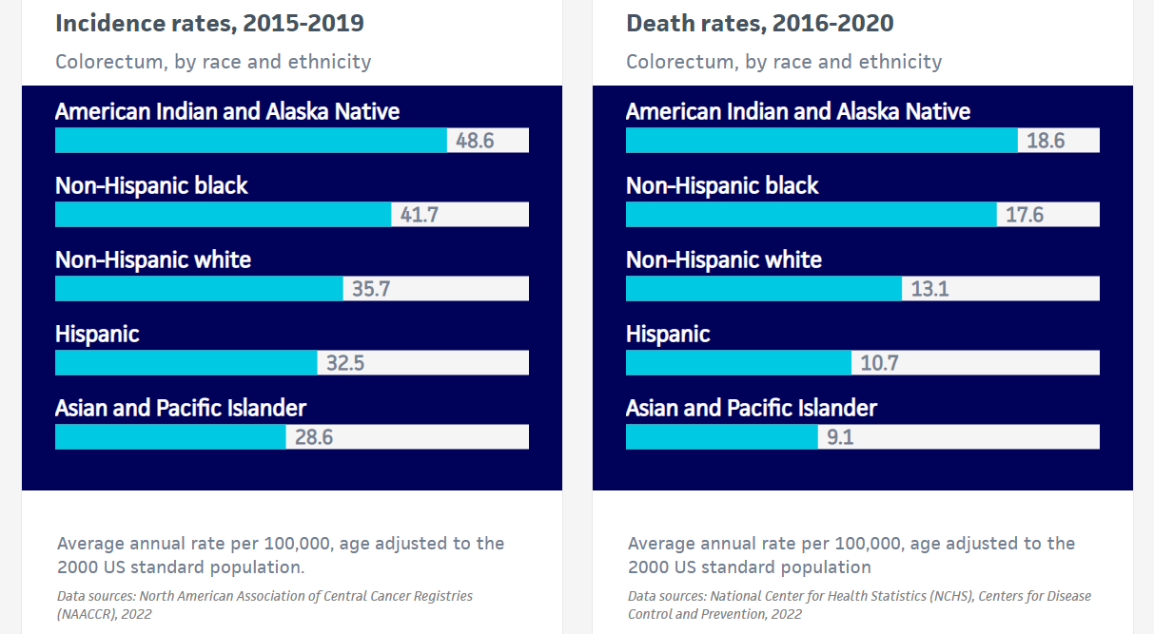
COLORECTAL CANCER RATES

Slide 21

RACIAL AND ETHNIC DISPARITIES
CRC incidence rates are highest in people who are:
Alaska Native (about 89 new diagnoses out of every 100,000 Alaskan Native people)
American Indian (about 46 new diagnoses out of 100,000 American Indian people)
Black (about 42 new diagnoses out of 100,000 Black people)
Notes:
In 2023, an estimated 153,020 people will be diagnosed with CRC.
The CRC incidence rate was 33% higher in men (about 42 new diagnoses out of every 100,000 men) than in women (about 31 new diagnoses out of every 100,000 women) during 2015 through 2019.
The overall incidence rate in White people is almost 36 people out of every 100,000 White people. CRC incidence rates are highest in people who are:
Alaska Native (about 89 new diagnoses out of every 100,000 Alaskan Native people)
American Indian (about 46 new diagnoses out of 100,000 American Indian people)
Black (about 42 new diagnoses out of 100,000 Black people)
CRC incidence is highest in parts of the South, Midwest, and Appalachia and lowest in the West. Incidence rates range from about 47 new diagnoses out of every 100,000 people in Mississippi to 27 in Utah.

Slide 22
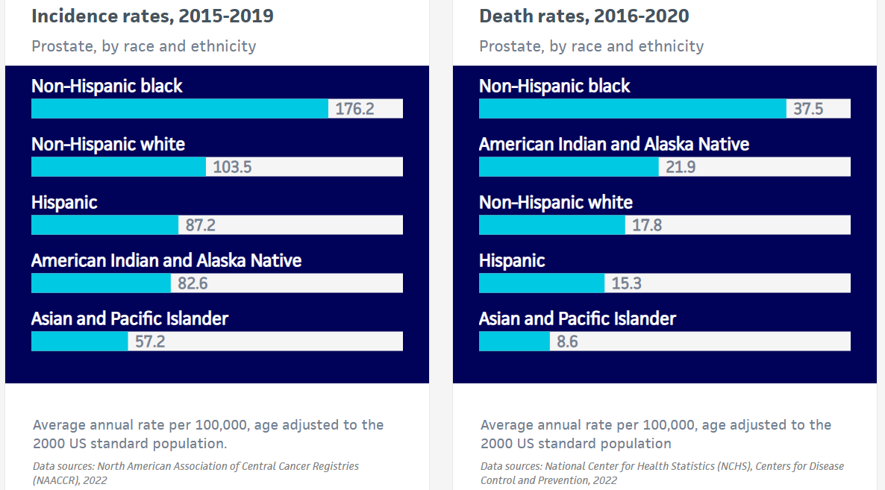
Racial and Ethnic Disparities
Notes:
Although there is some evidence that aggressive prostate cancer is more common in Black men, the larger disparity for mortality than incidence largely reflects less access to high-quality treatment. Studies continue to document that Black men are relatively more likely to receive substandard treatment for prostate cancer. Recently, it was reported that Black men diagnosed with advanced-stage prostate cancer were significantly less likely to receive any treatment compared to White men, even when accounting for similar insurance. When treatment is similar, prostate cancer 10-year survival is comparable or even higher among Black men. Source: https://www.cancer.org/content/dam/cancer-org/research/cancer-facts-and-statistics/cancer-facts-and-figures-for-african-americans/2022-2024-cff-aa.pdf
Incidence differences may reflect lower prevalence of screening in Hispanic men Source: https://www.cancer.org/content/dam/cancer-org/research/cancer-facts-and-statistics/cancer-facts-and-figures-for-hispanics-and-latinos/hispanic-latino-2021-2023-cancer-facts-and-figures.pdf

Slide 23

African American/ Black Men &
Prostate Cancer
Incidence is 70% higher in Black than White men for reasons that remain unclear.
1 in 6 Black men will be diagnosed in their lifetime compared to 1 in 8 White men
Black men have the highest death rate of prostate cancer of any racial or ethnic group in the US, 2 times higher than White men
Notes:
Although there is some evidence that aggressive prostate cancer is more common in Black men, the larger disparity for mortality than incidence largely reflects less access to high-quality treatment. Studies continue to document that Black men are relatively more likely to receive substandard treatment for prostate cancer. Recently, it was reported that Black men diagnosed with advanced-stage prostate cancer were significantly less likely to receive any treatment compared to White men, even when accounting for similar insurance. When treatment is similar, prostate cancer 10-year survival is comparable or even higher among Black men. Source: https://www.cancer.org/content/dam/cancer-org/research/cancer-facts-and-statistics/cancer-facts-and-figures-for-african-americans/2022-2024-cff-aa.pdf

Slide 24
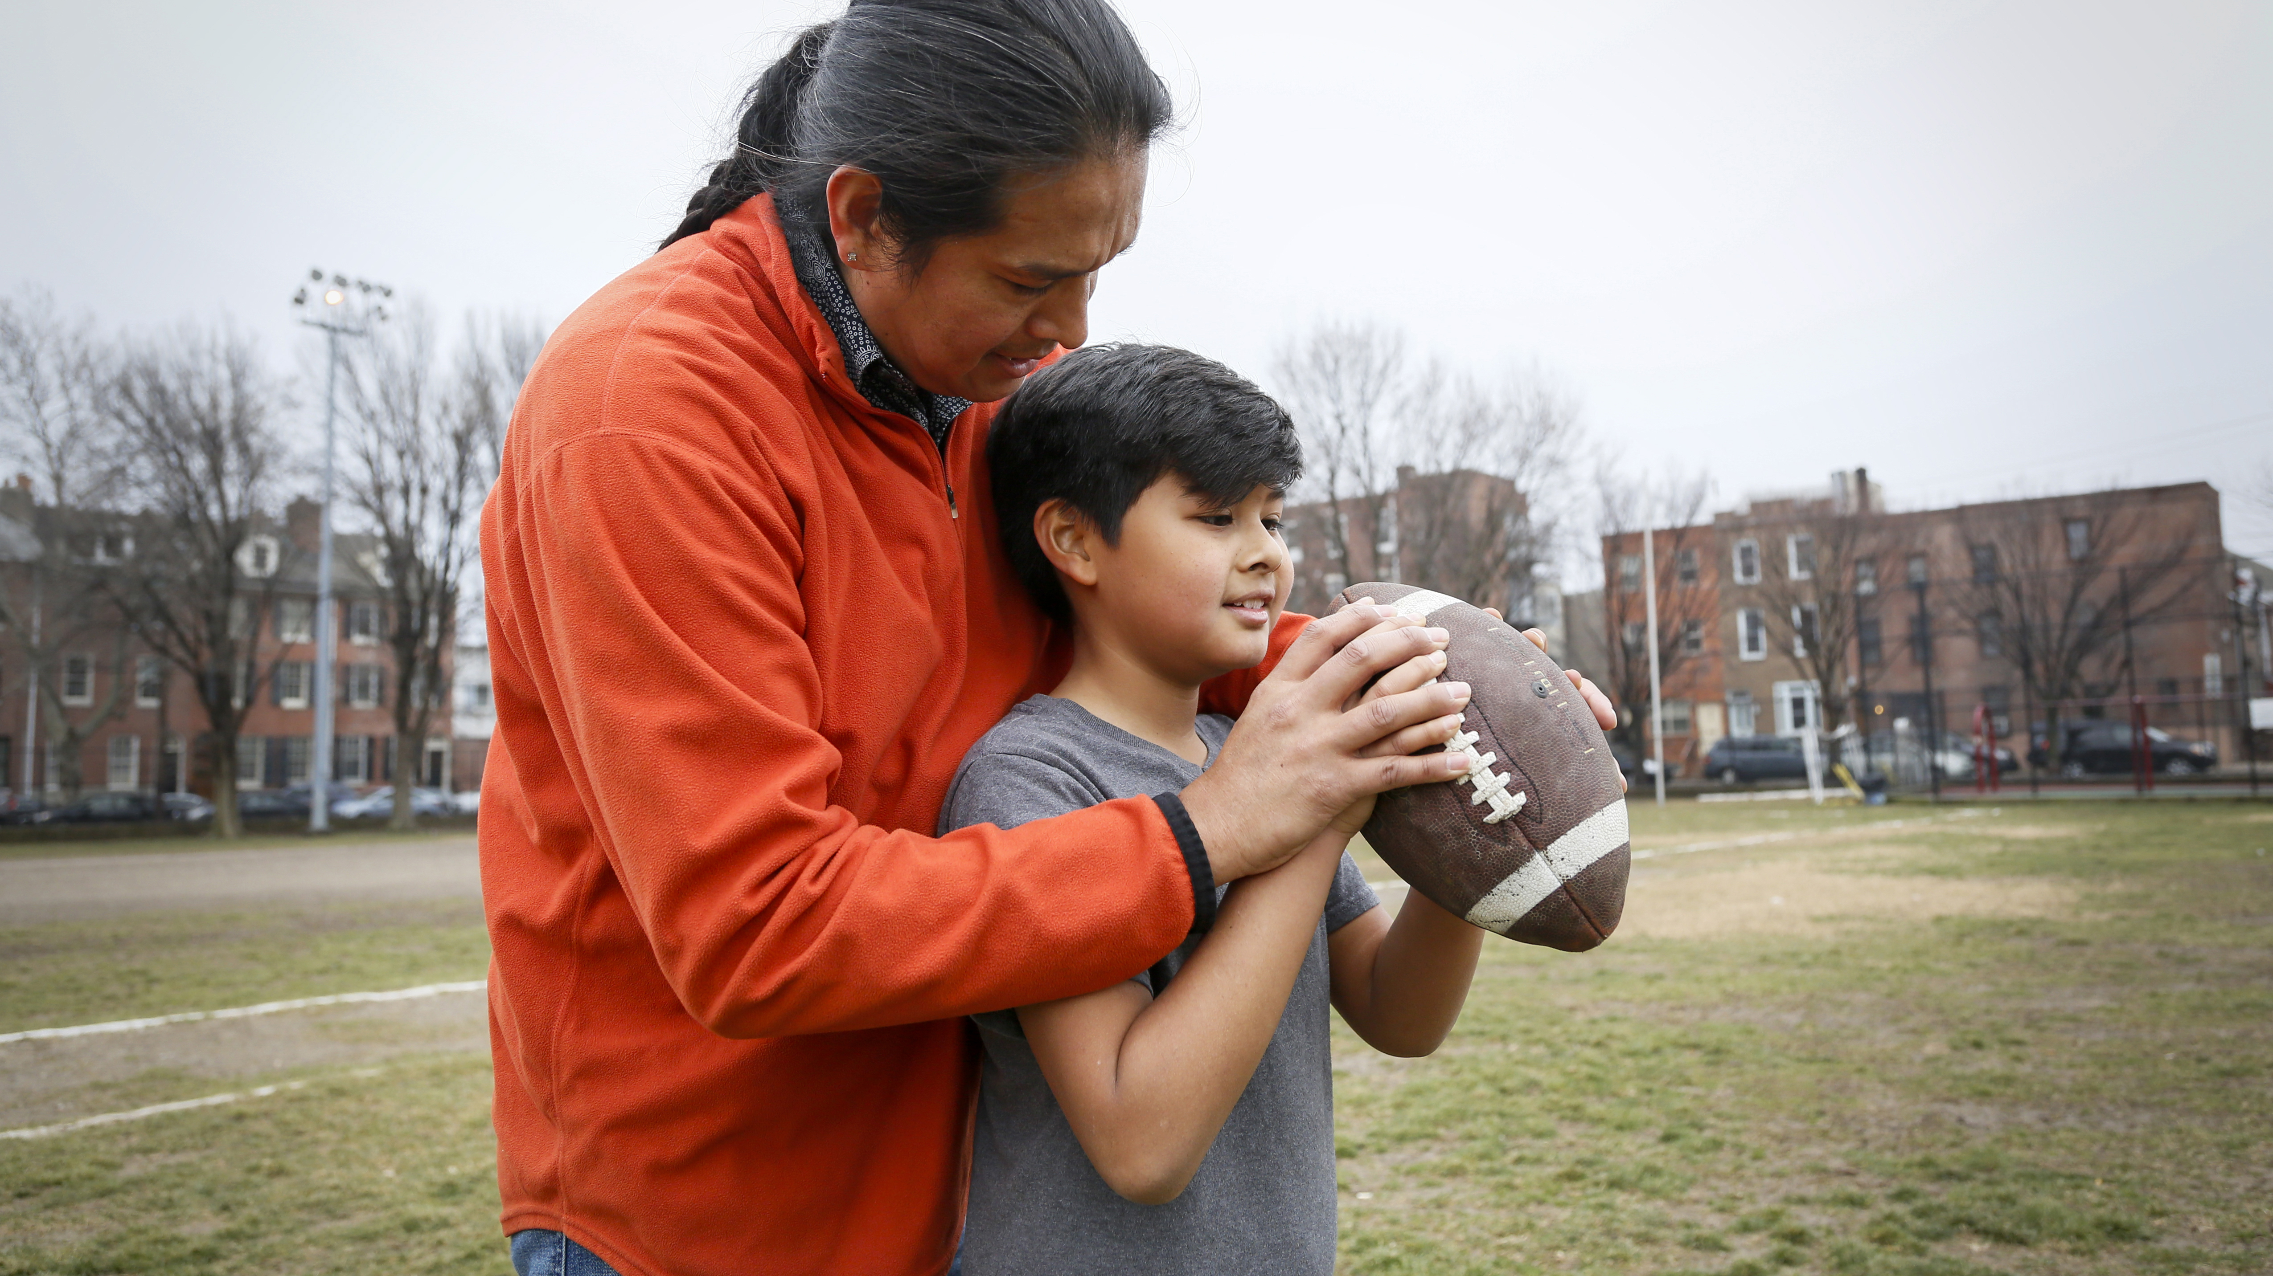
Native/Indigenous American and
Alaska Native Men & Prostate Cancer
American Indian and Alaska Native men are near the bottom in incidence from prostate cancer (82.6 out of 100,000) but 2nd only to Black men in death rates, (21.9 out of 100,000).

Slide 25

Hispanic/Latino Men & Prostate Cancer
Incidence and mortality rates are 12% lower in Hispanic men compared to non-Hispanic White men
However, Hispanic men are less likely to be diagnosed at a localized stage
Notes:
Incidence differences may reflect lower prevalence of screening in Hispanic men Source: https://www.cancer.org/content/dam/cancer-org/research/cancer-facts-and-statistics/cancer-facts-and-figures-for-hispanics-and-latinos/hispanic-latino-2021-2023-cancer-facts-and-figures.pdf

Slide 26
Cancer
Risk Factors

Slide 27
RISK FACTORS FOR CANCER
A risk factor is anything that increases your chance of getting a disease such as cancer.
Different cancers have different risk factors. Some risk factors, like smoking, can be changed. Others, like a person’s age or family history, can’t be changed.
Having a risk factor, or even many, does not mean that you will get the disease. And some people who get the disease may not have any known risk factors.
Risk factors are determined by conditions and described as:
Average risk
Increased risk or high risk

Slide 28



Risk Factors for Breast cancer
Age
Being Born Female
  Men can get it too, but it is much more common in women
Family History
  Inheriting Certain Gene Changes
Breast Tissue Density
Hormone Therapy
Reproductive History
  Monthly periods started before the age of 12
  Never had children or had 1st live birth after the age of 30
  Started menopause after the age of 55
Certain non-cancerous breast problems can increase risk
Diagnosis of Lobular carcinoma in situ
Alcohol
Weight
Inactivity

Slide 29

ACS RECOMMENDATIONS FOR THE EARLY DETECTION OF BREAST CANCER FOR WOMEN AT AVERAGE RISK
Women ages 40 to 44 should have the choice to start annual breast cancer screening with mammograms if they wish to do so.
Women aged 45 to 54 should get mammograms every year.
Women 55 and older should switch to mammograms every 2 years or can continue yearly screening.

Slide 30
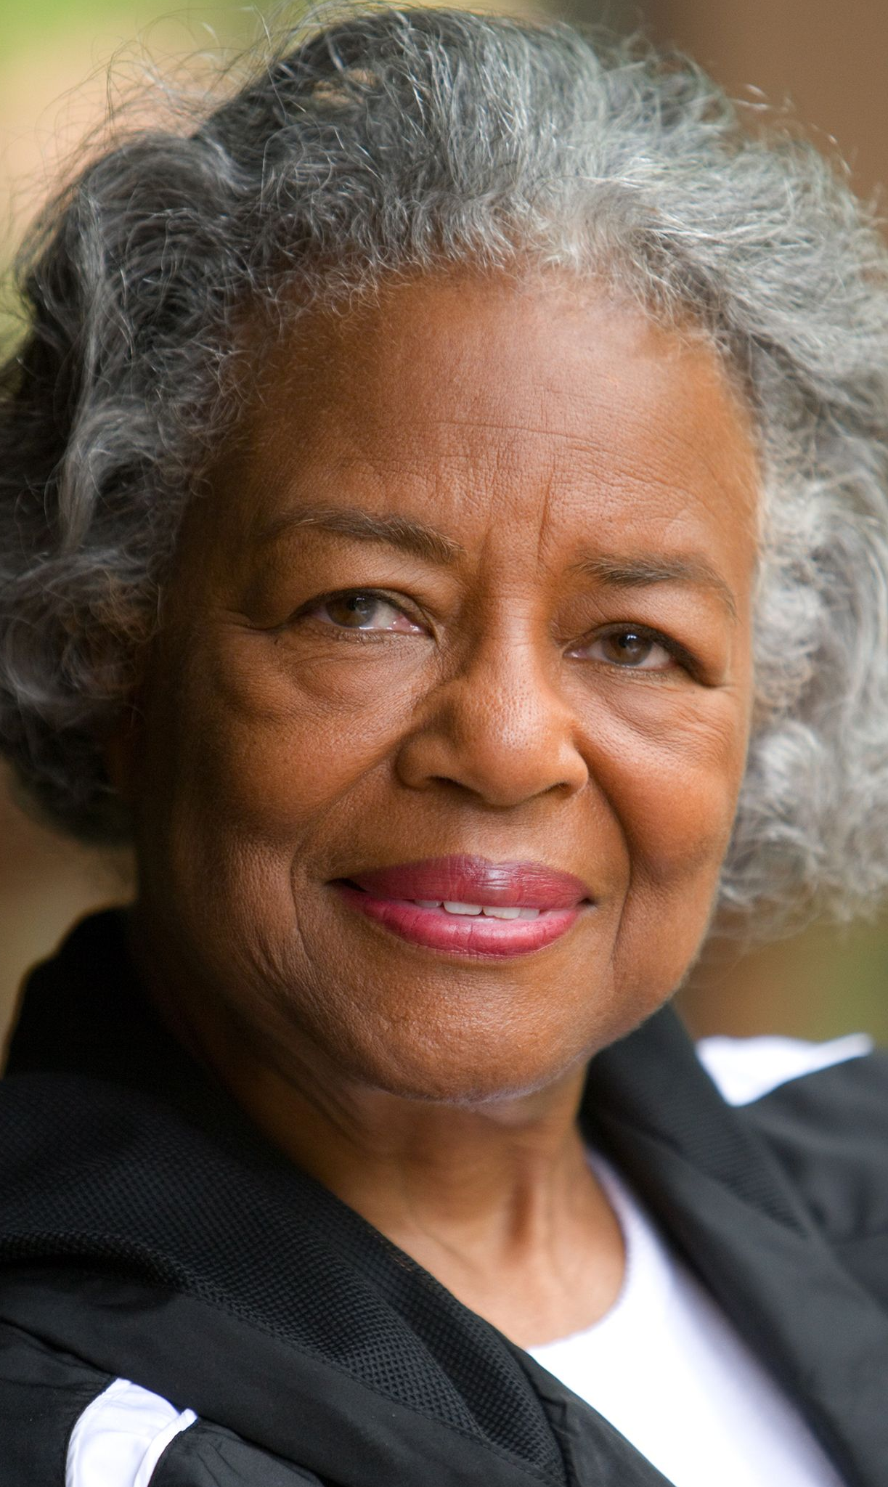
ACS RECOMMENDATIONS FOR THE EARLY DETECTION OF BREAST CANCER FOR WOMEN AT AVERAGE RISK
Mammograms for older women should be based on the individual, her health, and other serious illnesses she might have.
It is generally recommended that screening should continue as long as a woman is in good health and is expected to live 10 more years or longer.
Women should also know how their breasts normally look and feel.
Report any breast changes to a health care provider right away.
Screening tests are used to find cancer before a person has any symptoms.
All women should be familiar with the known benefits, limitations, and potential harms linked to breast cancer screening.

Slide 31

ACS RECOMMENDATIONS FOR THE EARLY DETECTION OF BREAST CANCER FOR WOMEN AT HIGH RISK
Some women* – because of their family history, a genetic tendency, or certain other factors that put them at high risk – should be screened with MRIs along with mammograms.
*The number of women who fall into this category is very small.
Talk with a health care provider about your risk for breast cancer and the best screening plan for you.

Slide 32
RISK FACTORS FOR COLORECTAL CANCER
About half of colorectal cancers in the US are attributable to these potentially modifiable risk factors:
  Carrying excess body weight
  Being physically inactive
  Smoking for many years
  Eating too much red or processed meat
  Not eating enough foods with calcium, such as milk, fortified plant-based milk such as soy or almond milk, fortified orange juice, and tofu that contains calcium salt
  Drinking too much alcohol
  Eating very few fruits, vegetables, and whole grains.
Alcohol
Weight
Inactivity

Slide 33

RISK FACTORS FOR PEOPLE AT AVERAGE RISK FOR
COLORECTAL CANCER
Age
  9 out of every 10 of Colorectal Cancers are found in men and women age 50 and older.
Diet
  High in red meats (like beef, pork, or lamb)
  High in processed meats (like hot dogs, bacon, or cold cuts)
  Not enough fruits and vegetables

Slide 34
RISK FACTORS FOR PEOPLE AT HIGH RISK FOR COLORECTAL CANCER
The following conditions place you at an increased or higher than average risk:
A personal history of
  Polyps
  Colorectal Cancer
  Inflammatory bowel disease
    Ulcerative Colitis
    Crohn's Disease
  A family history of Colorectal Cancer or polyps
  Hereditary Colorectal Cancer syndrome
  If you have any of these conditions, talk with your doctor about starting testing at an earlier age.

Slide 35

Colorectal Cancer is often preventable and can almost always be treated successfully if found early.
Beginning at age 45, people at average risk should talk to their doctor about what screening test for Colorectal Cancer is best for them.
There are several tests used to help find Colorectal Cancer early. No matter which test you choose, the most important thing is to get tested.
People at increased or high risk of Colorectal Cancer may need to start Colorectal Cancer screening before age 45, be screened more often, and/or get specific tests.
COLORECTAL CANCER SCREENING RECOMMENDATIONS & TESTS

Slide 36
ACS RECOMMENDATIONS FOR THE EARLY DETECTION OF COLORECTAL CANCER FOR PEOPLE AT AVERAGE RISK
The ACS recommends that people at average risk of Colorectal Cancer start regular screening at age 45.
For screening, people are considered to be at average risk if they
do not have:
  A personal history of Colorectal Cancer or certain types of polyps.
  A family history of Colorectal Cancer.
  A personal history of inflammatory bowel disease (Ulcerative Colitis or Crohn's Disease).
  A confirmed or suspected inherited Colorectal Cancer syndrome, such as familial adenomatous polyposis (FAP) or Lynch syndrome (hereditary non-polyposis Colorectal Cancer or HNPCC).
  A personal history of getting radiation to the abdomen (belly) or pelvic area to treat a prior cancer.

Slide 37
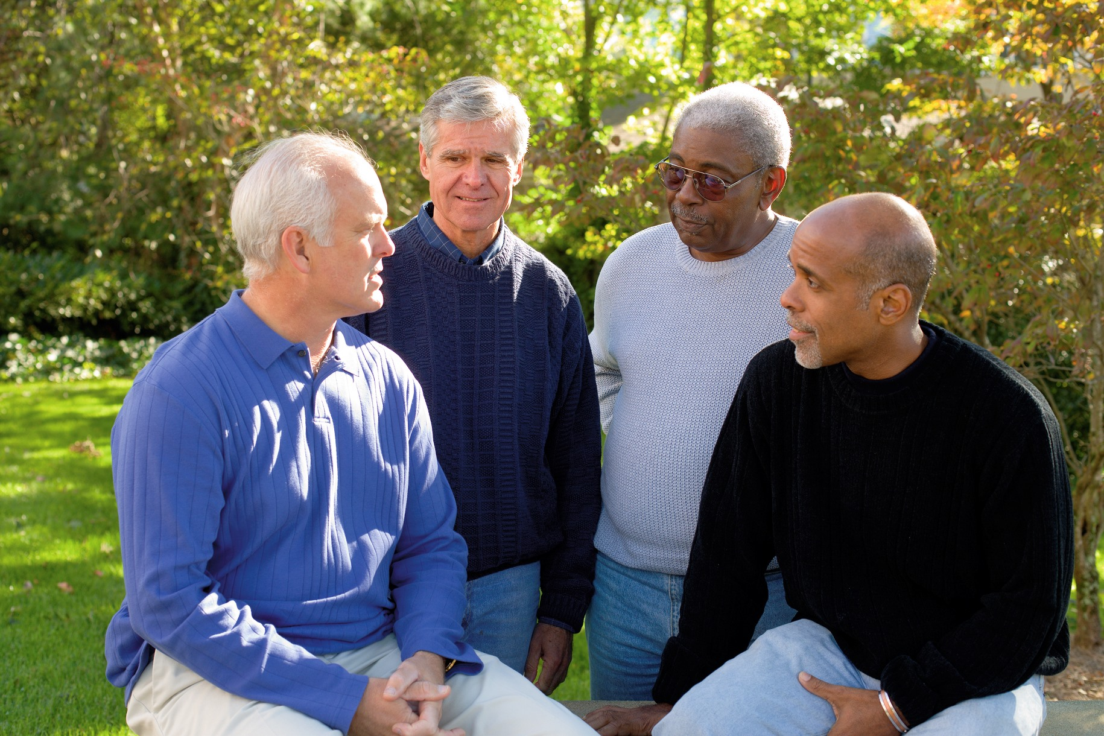
Prostate Cancer
Risk Factors
Age
  The chance of being diagnosed with prostate cancer goes up quickly after age 50.
Race/Ethnicity
Black men have a higher risk than men of other races.
The reasons for these racial and ethnic differences are unclear.
Notes:
Bullet 1:
About 6 in 10 cases of prostate cancer are found in men older than 65.
Bullet 2:
When prostate cancer develops in African-American men and in Caribbean men of African ancestry, these men tend to be younger. Prostate cancer occurs less often in Asian-American and Hispanic/Latino men than in non-Hispanic whites.

Slide 38

Prostate Cancer
Risk Factors
Gene changes
58% of variability in prostate cancer rates are due to inherited genetic factors.
Diet
Diets high in red meat or animal fats (especially dairy products) and low in fruits and vegetables may raise risk.
Geography
Prostate cancer incidence is most common in North America, Northwestern Europe, Australia, and on Caribbean islands.
Mortality rates are highest in parts of Africa, South America, and the Caribbean.
Notes:
Bullet 1 (Gene changes):
Inherited mutations (changes) of the BRCA1 or BRCA2 genes can increase prostate cancer risk in men (especially mutations in BRCA2).
Men with Lynch syndrome (also known as hereditary non-polyposis colorectal cancer, or HNPCC), a condition caused by inherited gene changes, have an increased risk for a number or cancers, including prostate cancer.
Bullet 2 (Diet):
The exact role of diet in prostate cancer is not clear, although several different factors have been studied.
Men who eat a lot of dairy products appear to have a slightly higher chance of getting prostate cancer. Some studies have suggested that men who consume a lot of calcium (through food or supplements) may have a higher risk of developing prostate cancer. It's important to note that calcium is known to have other important health benefits. Talk to your doctor about
Bullet 3 (Geography)
The reasons for this are not clear.

Slide 39
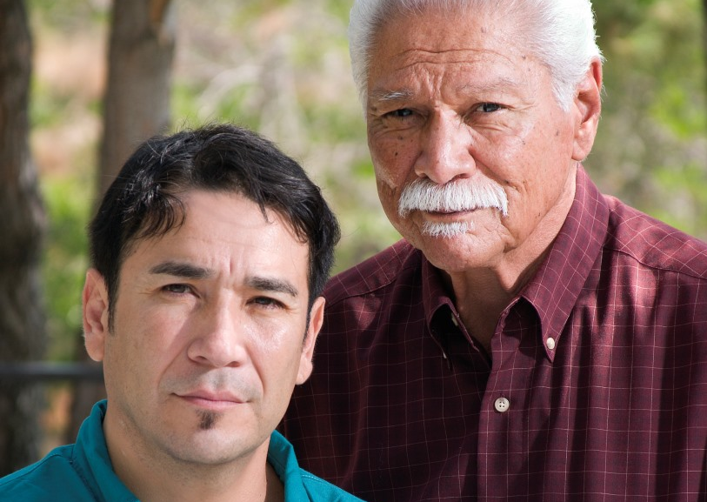
Prostate Cancer
Risk Factors
Family history
Having a father or brother with prostate cancer more than doubles a man’s risk of developing this disease.
The risk is much higher for men with several affected relatives, particularly if their relatives were young at the time the cancer was found.
Men with a sister or mother with breast cancer are also at higher risk of prostate cancer.
Notes:
Bullet 1 (Family history):
Prostate cancer seems to run in some families, which suggests that in some cases there may be an inherited or genetic factor.
While a family history increases a man's risk for prostate cancer, most men diagnosed with prostate cancer don't have a family history.

Slide 40

Lowering Prostate Cancer Risk
Supplements, minerals, and vitamins
There is some evidence that Vitamin D supplements may lower prostate cancer mortality.
Other vitamins, supplements, or medicines have not been proven to lower the risk of prostate cancer, while some may potentially increase the risk of those eating a healthy diet.
Taking any supplements can have risks and benefits. Talk to your doctor before starting any vitamins or other supplements.
Medicines
Some drugs like cholesterol lowering medications or statins might help reduce the risk of prostate cancer.
Notes:
Medicines
5-alpha reductase inhibitors: 5-alpha reductase inhibitors prevent the body from changing testosterone into dihydrotestosterone (DHT), the main hormone that causes the prostate to grow. Right now, it isn’t clear that taking one of these drugs just to lower prostate cancer risk is very helpful. Still, men who want to know more about these drugs should discuss them with their doctors.
Aspirin: Some research suggests that men who take a daily aspirin might have a lower risk of getting and dying from prostate cancer. But more research is needed to show if the possible benefits outweigh the risks. Long-term aspirin use can have side effects, including an increased risk of bleeding in the digestive tract. While aspirin can also have other health benefits, at this time most doctors don’t recommend taking it just to try to lower prostate cancer risk.

Slide 41
SUMMARY

Slide 42

Breast cancer is the most common cancer in American women.
African American women are 40% more likely to die of breast cancer than white women and are twice as likely to die if they are over 50.
African American women are twice as likely to be diagnosed with triple-negative breast cancers.
There is HOPE! Advances in prevention, early detection, and treatments continue to give hope, save lives, and improve the quality of life for people at risk for or who have Breast Cancer.

Slide 43
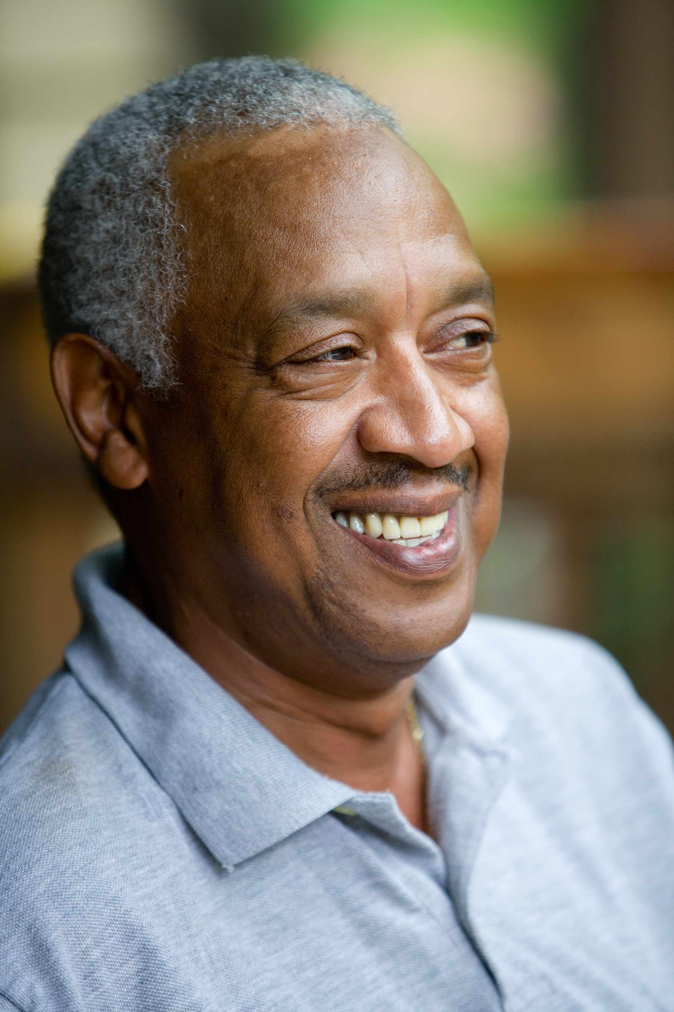
Regular Colorectal Cancer screening can save lives and the percentage of adults in the United States who are up-to-date with screening had been increasing prior to the COVID-19 pandemic.
Screening rates have dropped significantly during the pandemic.
Screening rate disparities between Blacks and Whites have decreased in recent years.
Lower screening rates in Hispanics, Asian Americans, and Native Americans.

Slide 44

Prostate is the most common cancer in American men and the 2nd most common cancer in America.
Men of African descent have the highest incidence and mortality rates of all racial groups in America.
Beginning at age 50, men who are at average risk should start talking to their doctor about prostate cancer screening.
Men at high risk of prostate cancer should talking to their doctor at age 45 about screening.
There is emerging information that healthy lifestyle can lower risk of aggressive forms of prostate cancer. Advances in prevention, early detection, and treatment continue to give hope, save lives, and improve the quality of life for men who are at risk or who have prostate cancer.

Slide 45
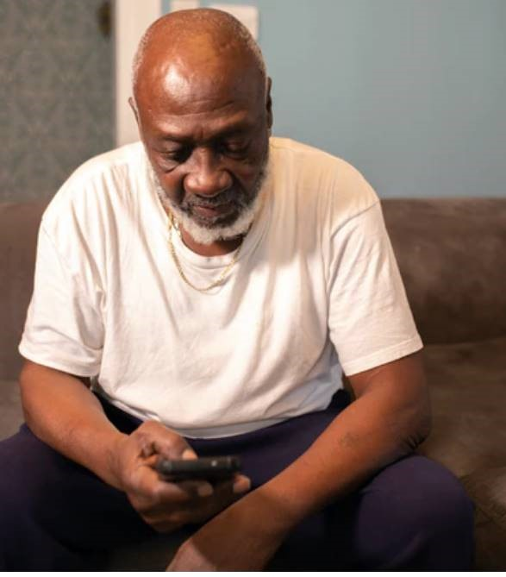
Thank You
You can get more information on
cancer screening on our website, cancer.org, or call
1-800-227-2345 and talk with one of our Cancer Information Specialists 24/7, 365 days a year.

